Slide 1
k-means clustering
biological data science
spring 2019

Slide 2
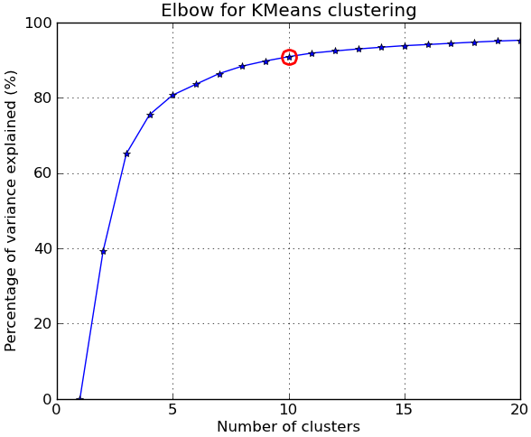

Slide 3
k-means
How can we define the objective of this algorithm?
Finding optimal solution is NP-hard
Video presented a common approximation: Lloyd’s algorithm
How can we use k-means for non-Euclidean networks with unweighted edges?
Define a centroid as an actual node in the cluster and distance between two nodes as the length of the shortest path
How can we find the shortest path?
Breadth-First Search (BFS)

Slide 4
Time complexity
For each iteration:
How can we determine distances between each vertex and every centroid?
Time to run BFS from each centroid to all nodes?
O(k (V + E))
Time to reassign each vertex to nearest centroid?
O(k * V)
Recompute centroids for each cluster
We can use all-pairs shortest paths
O(V³)
Total time for i iterations?
O(i * V³)

Slide 5
k-means considerations
Pros:
- Usually runs fairly fast, can scale to large datasets
Cons:
- Selection of different starting points can yield vastly different results – lack of stability
- Use of centroids leads to ‘sphericity’ bias

Slide 6
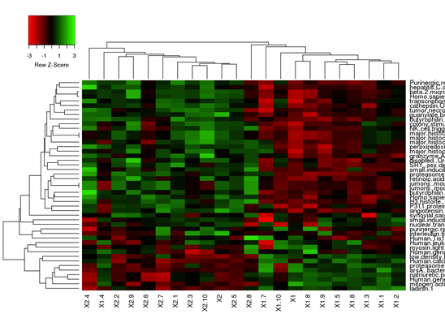
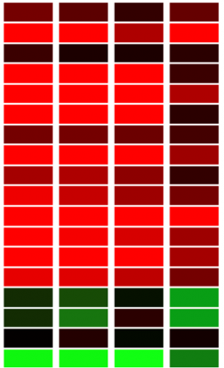
Gene/protein heatmaps Columns represent individuals, rows represent genes or proteins, colors represent expression levels (red = high, green = low)

Slide 7
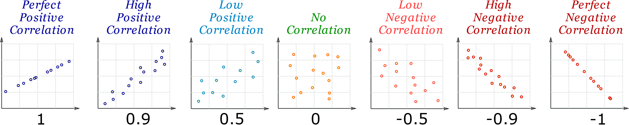
Correlation / anti-correlation

Slide 8
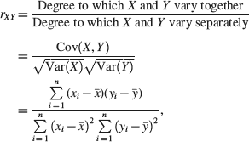
Pearson’s Correlation Coefficient
I have PCC code you can use

